Slide 1
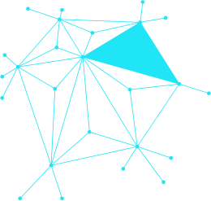





MAESTA
AI-Powered Platform
Graduation Project
MAESTA Inc.
AI-Powered Recruitment & Freelancing
Page 01

Slide 2

AGENDA
01 · Problem Statement
02 · Project Objectives
03 · Solution Overview
04 · Key Features
05 · AI Features
06 · System Architecture
07 · Database Design
08 · User Roles
09 · Recruitment Workflow
10 · Freelancing Workflow
11 · AI Workflow (LLM + RAG)
12 · Technology Stack
13 · Challenges
14 · Future Enhancements
15 · Screenshots
16 · Results & Conclusion
MAESTA Inc.
AI-Powered Recruitment & Freelancing Platform
Page 02

Slide 3


Problem Statement
Current recruitment and freelancing platforms suffer from inefficient candidate matching, time-consuming manual screening, lack of AI-driven insights, and poor alignment between talent and opportunity — leaving businesses and freelancers underserved.
MAESTA
Recruitment & Freelancing Challenges
Page 03

Slide 4



Project Objectives
Build an AI-powered platform for intelligent job matching between recruiters, employers, and freelancers.
Create seamless, automated recruitment and freelancing workflows powered by LLM and RAG technologies.
MAESTA
AI-Powered Recruitment & Freelancing
Page 04

Slide 5

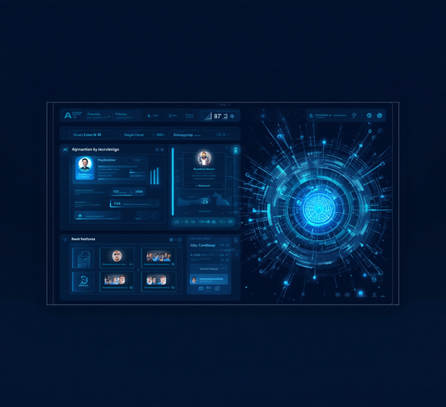

Solution Overview
MAESTA is a unified AI-driven platform seamlessly combining recruitment and freelancing. It delivers intelligent talent matching, automated candidate screening, and smart project recommendations — connecting employers, job seekers, and freelancers in one ecosystem.
MAESTA Inc.
AI-Powered Recruitment & Freelancing
Page 05

Slide 6


Key Features
01
02
03
Smart Job Matching
Automated Screening
Real-time Collaboration
AI-driven algorithms analyze candidate profiles and job requirements to deliver precise, personalized job matches — reducing time-to-hire and improving placement quality.
Automated resume parsing and intelligent shortlisting filters applicants by skills, experience, and fit — enabling recruiters to focus on top-tier candidates instantly.
Built-in messaging, file sharing, and project tracking tools empower teams and freelancers to collaborate seamlessly across recruitment and project workflows.
MAESTA Inc.
AI-Powered Recruitment
Page 06

Slide 7
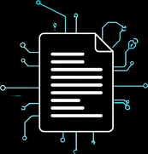



Natural Language Processing
AI-Powered Features
Advanced NLP engine automatically parses and extracts skills, experience, and qualifications from CVs. Reduces manual screening time by up to 80% with high accuracy and multilingual support.
Intelligent Skill Matching
AI-driven semantic matching algorithms align candidate profiles with job requirements. Goes beyond keyword search to understand context, competency levels, and role fit with precision scoring.
Predictive Hiring Analytics
Machine learning models analyze historical hiring data to predict candidate success rates, time-to-hire, and retention likelihood — empowering data-driven recruitment decisions.
MAESTA Inc.
AI Features
Page 07

Slide 8

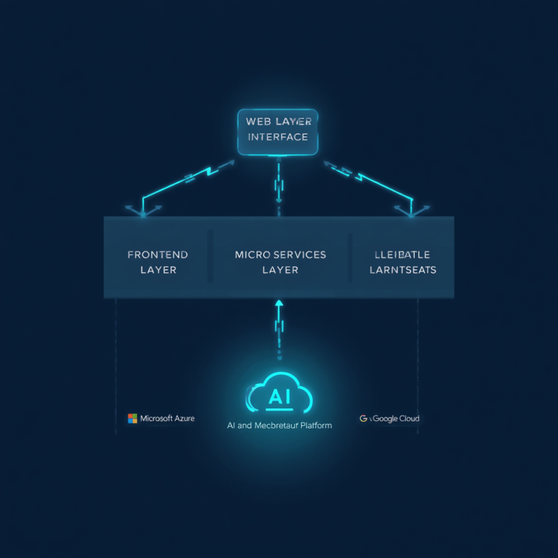
System Architecture
Frontend Layer → Backend Services → AI/ML Engine
Frontend: React.js SPA with responsive UI, role-based dashboards for recruiters, freelancers & admins.
Backend: ASP.NET Core Web API (.NET 8/9), clean architecture, JWT authentication, SignalR for real-time chat & notifications.
AI/ML Engine: Python Flask-based AI Service using LangGraph & RAG (FAISS + BM25) with Ollama & Gemini — powers chatbot, ATS matching, quiz generation, & automated interviews.
Data Layer: Microsoft SQL Server (150+ performance indexes) + SQLite (AI Service) + MinIO Object Storage (S3-compatible).
MAESTA Inc.
MAESTA – AI Recruitment Platform
Page 8

Slide 9
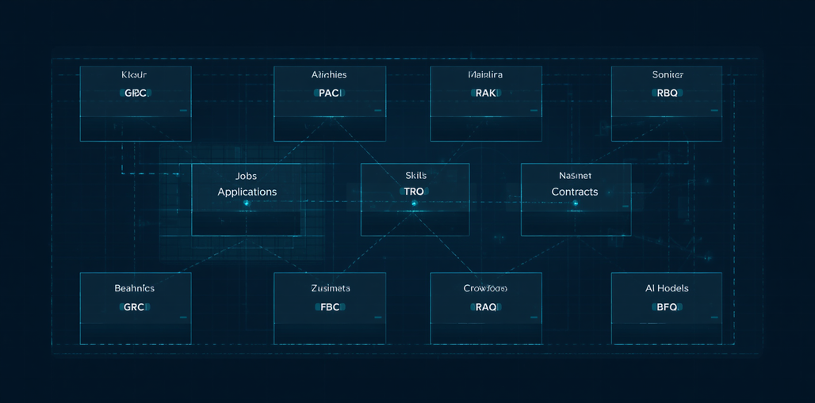
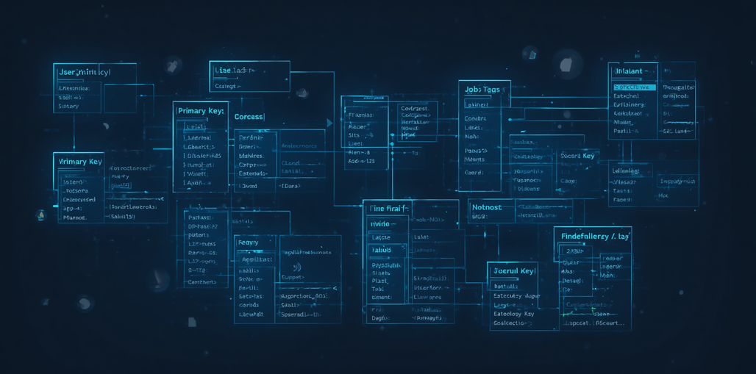
Database Design
ERD Overview: Core entities — Users, Jobs, Applications, Skills, Contracts & AI Models — linked via relational keys to power MAESTA's full recruitment and freelancing lifecycle.
MAESTA Inc.
Database Design (ERD)
Page 09

Slide 10

User Roles
01
02
03
Job Seeker / Freelancer
Recruiter / Employer
Platform Administrator
Browses job listings, applies to positions, creates a freelance profile, bids on projects, and leverages AI-powered CV matching to maximize visibility and opportunities.
Posts job vacancies and freelance projects, reviews AI-ranked candidate profiles, manages hiring pipelines, and communicates directly with applicants through the platform.
Manages platform users, monitors activity and compliance, configures AI parameters, oversees content moderation, and maintains system health and security settings.
MAESTA Inc.
MAESTA Platform
Page 10

Slide 11
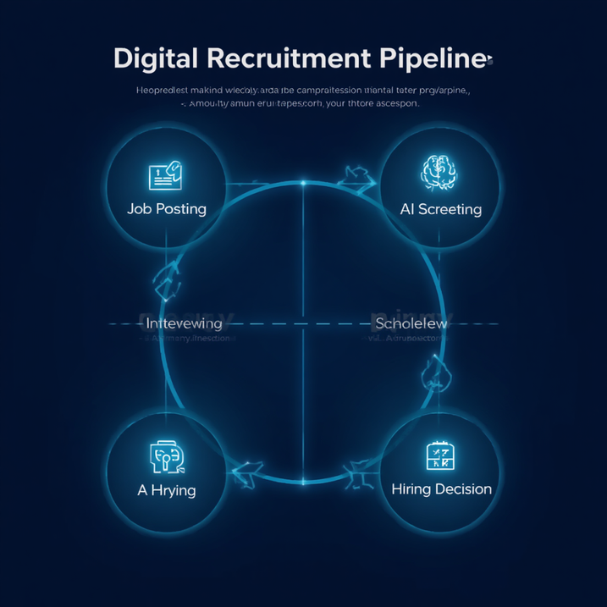
Recruitment Workflow
Job Posting → AI Screening → Interview Scheduling → Hiring Decision
Employers post jobs with required skills and criteria. MAESTA's AI engine auto-screens applicants using NLP-based resume parsing and scoring. Qualified candidates are ranked and shortlisted automatically. Interview slots are suggested based on availability. Final hiring decisions are supported by AI-generated match scores and recommendations — reducing time-to-hire by up to 60%.
MAESTA Inc.
AI-Powered Recruitment Platform
Page 11

Slide 12


Freelancing Workflow
Project Posting → AI Matching → Proposal Submission → Contract & Payment
Clients post projects with detailed requirements; MAESTA's AI engine instantly matches them with top-ranked freelancers based on skills, ratings, and availability. Freelancers submit tailored proposals, which clients review through a streamlined dashboard. Upon acceptance, smart contracts govern milestones, deliverables, and automated payment releases — ensuring transparency and trust at every stage.
MAESTA Inc.
Freelancing Workflow
Page 12

Slide 13

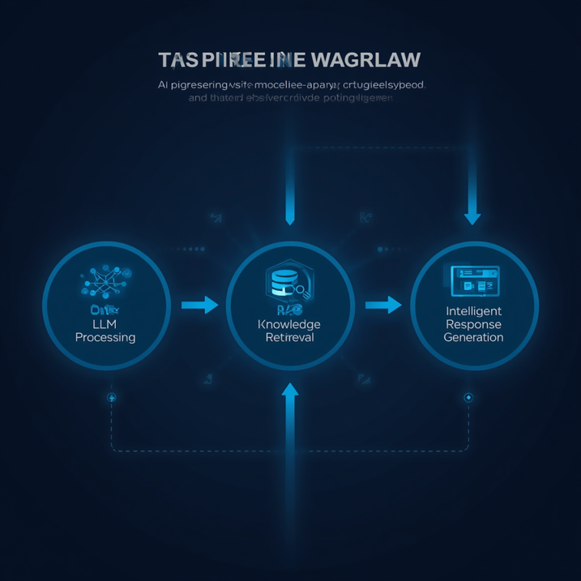
AI Workflow
LLM Processing → RAG Knowledge Retrieval → Intelligent Response Generation
MAESTA leverages a multi-stage AI pipeline to deliver intelligent recruitment and freelancing assistance. User queries are first processed by a Large Language Model (LLM) for intent understanding and context extraction. The RAG (Retrieval-Augmented Generation) layer then fetches relevant knowledge from structured job, candidate, and project databases. Finally, the system synthesizes a precise, context-aware response — powering smart matching, automated screening, and dynamic recommendations in real time.
MAESTA Inc.
AI Workflow – LLM + RAG
Page 13

Slide 14
AI Workflow
LLM Processing → RAG Knowledge Retrieval → Intelligent Response Generation
MAESTA leverages a multi-stage AI pipeline to deliver intelligent recruitment and freelancing assistance. User queries are first processed by a Large Language Model (LLM) for intent understanding and context extraction. The RAG (Retrieval-Augmented Generation) layer then fetches relevant knowledge from structured job, candidate, and project databases. Finally, the system synthesizes a precise, context-aware response — powering smart matching, automated screening, and dynamic recommendations in real time.
MAESTA Inc.
AI Workflow – LLM + RAG
Page 13

Slide 15





Frontend Layer
Technology Stack
React 19 for dynamic UI components with custom layouts. Tailwind CSS and CSS Modules for responsive design. CRACO configuration for optimized production builds.
Backend & AI Services
ASP.NET Core (C#) Web API for RESTful APIs and SignalR real-time hubs. Python (Flask) for AI services, LangGraph agent orchestration, ATS pipelines, and RAG search.
Cloud & Infrastructure
Microsoft SQL Server for relational databases, SQLite for local configurations, and FAISS for vector storage. MinIO for object file storage. Deployed on secure scalable VMs.
MAESTA Inc.
Technology Stack
Page 14

Slide 16


Challenges
AI model accuracy optimization for job & freelancer matching.
Building a scalable real-time matching and recommendation system.
Ensuring data privacy, GDPR compliance, and secure user data handling.
MAESTA Inc.
MAESTA – AI Recruitment Platform
Page 15

Slide 17




Advanced AI Interviewing
Future
Enhancements
Implement real-time AI-driven interview simulations with voice recognition, sentiment analysis, and automated scoring to evaluate candidates objectively and reduce recruiter workload.
Blockchain-Based Credentials
Leverage blockchain technology to issue, verify, and store tamper-proof professional credentials and certifications, ensuring trust and transparency across the recruitment ecosystem.
Mobile Application Development
Build cross-platform iOS and Android mobile apps enabling recruiters, freelancers, and clients to manage profiles, jobs, contracts, and AI recommendations on the go.
MAESTA
AI-Powered Recruitment & Freelancing
Page 16

Slide 18

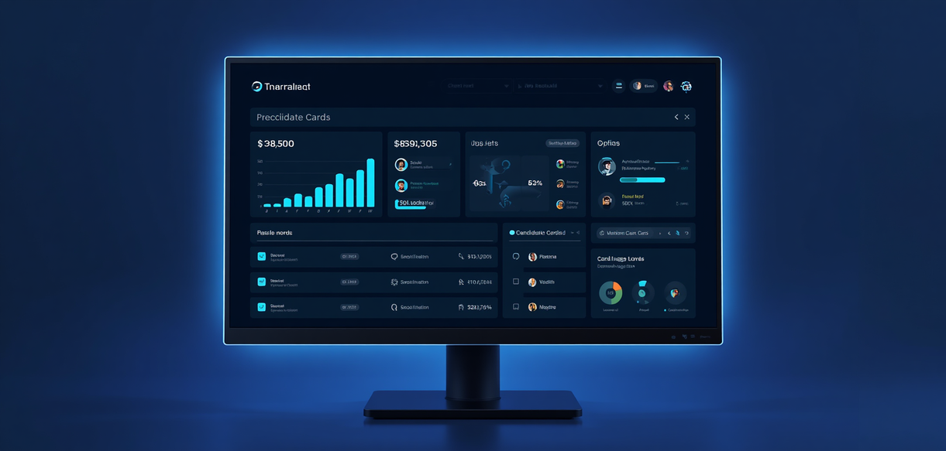


Dashboard View
Screenshots
A centralized dashboard providing real-time insights for recruiters and freelancers — active jobs, applications, AI match scores, and platform activity at a glance.
Job Matching Interface
AI-driven job matching screen displaying ranked candidates or opportunities with compatibility scores, skill tags, and one-click apply or invite actions.
Profile & Application Tracking
User profile management with portfolio, skills, and availability. Application tracking board shows pipeline stages: Applied, Reviewed, Interviewed, and Offered.
MAESTA Platform
AI-Powered Recruitment & Freelancing
Page 17

Slide 19

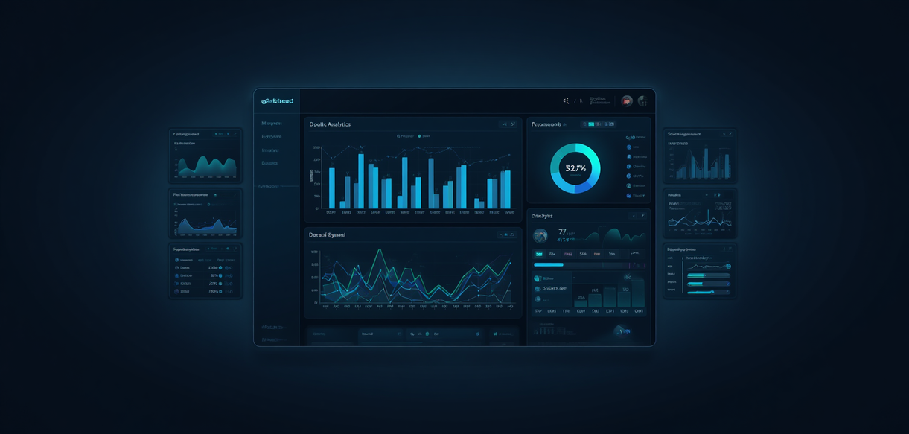
AI Recommendations Panel
More Screenshots
Intelligent candidate and job matching powered by LLM. The AI panel surfaces ranked suggestions, confidence scores, and reasoning for each recommendation in real time.
Freelance Project Board
Kanban-style board for freelancers and clients to track milestones, deliverables, and deadlines. Integrated with messaging and file sharing for seamless collaboration.
Analytics Dashboard & Admin Console
Platform-wide analytics with KPIs, user activity heatmaps, and AI performance metrics. Admin console enables role management, content moderation, and system configuration.
MAESTA
AI-Powered Recruitment & Freelancing
Page 18

Slide 20


Matching Accuracy +40%
Our AI-powered recommendation engine improved candidate-to-job matching accuracy by 40% compared to traditional keyword-based filtering, leveraging LLM embeddings and RAG-based profile analysis.
Results &
Achievements
Hiring Time Reduced by 60%
End-to-end recruitment workflows were streamlined through automated screening, smart shortlisting, and real-time notifications — cutting average time-to-hire by 60% in simulated scenarios.
MAESTA delivered measurable impact across recruitment efficiency, AI matching precision, and user satisfaction — validating our platform's real-world effectiveness.
Positive User Feedback
Beta testers and evaluators reported high satisfaction with platform usability, AI suggestions, and freelancing workflow clarity — with an average score of 4.6/5 across all user roles.
MAESTA Platform
Results & Achievements
Page 19

Slide 21


Conclusion
MAESTA demonstrates the transformative potential of AI in modernizing recruitment and freelancing. By integrating intelligent automation, LLM-powered matching, and a seamless dual-platform experience, MAESTA is ready for real-world deployment and scalable growth.
MAESTA Inc.
MAESTA – AI Recruitment & Freelancing
Page 20

Slide 22
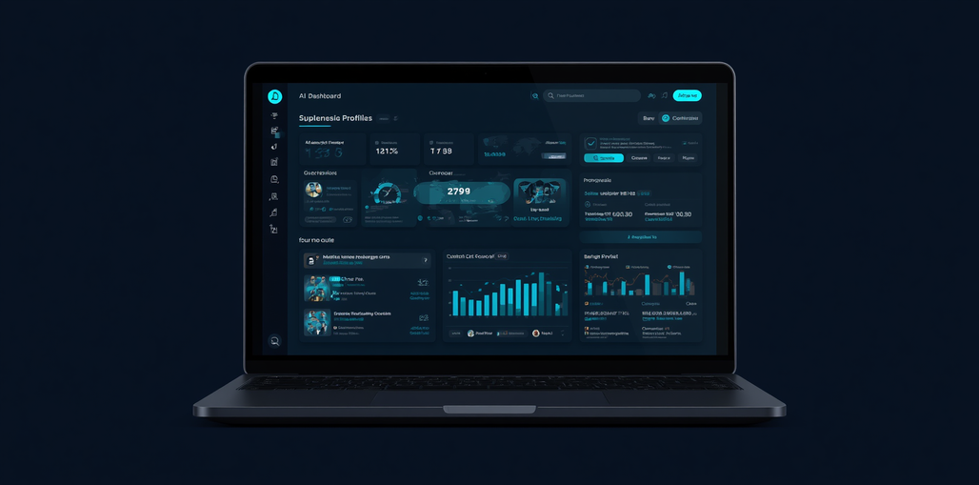
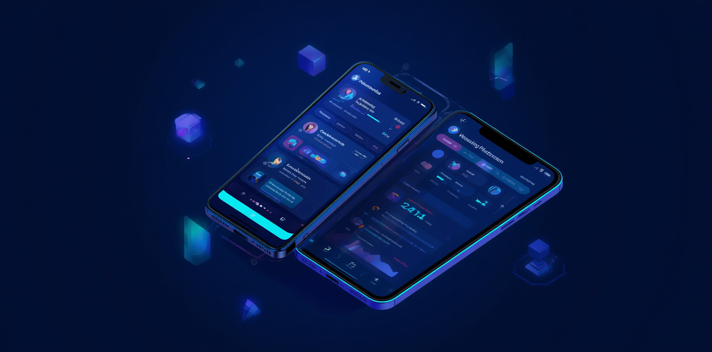
Live Demo
Interactive walkthrough of the MAESTA platform — showcasing AI-powered recruitment, freelancing workflows, smart matching, and real-time LLM capabilities.
▶ Demo in progress...
MAESTA Inc.
MAESTA – Live Demo
Page 21

Slide 23

Thank
You!
Questions & Discussion
MAESTA Inc.
AI-Powered Recruitment & Freelancing
Page 22

